Slide 1
Expanders & Ramanujan Graphs
G.Srinivasaraghavan, IIIT-B

Slide 2
Highly Connected Graphs
1
1
10
10
2
2
9
3
9
3
8
8
4
4
7
5
7
5
6
6

Slide 3
Connectedness – Why is it important?
Efficient Communication Networks – ‘well connected’ topologies achieve low latencies with as few links (cost?) as possible
Design of Rapidly Mixing Stochastic Processes – a random walk on a well connected graph is likely to converge to its stationary distribution quickly
Pseudorandom Generators – random walk on a well connected graph can be a very good source of pseudorandom bits – ‘randomness extraction’
Error Correcting Codes – a ‘richly connected’ graph between messages and their codes (bipartite) is likely to lead to enough candidates among the codes that are mutually separated by a minimum distance (such as Hamming distance).

Slide 4
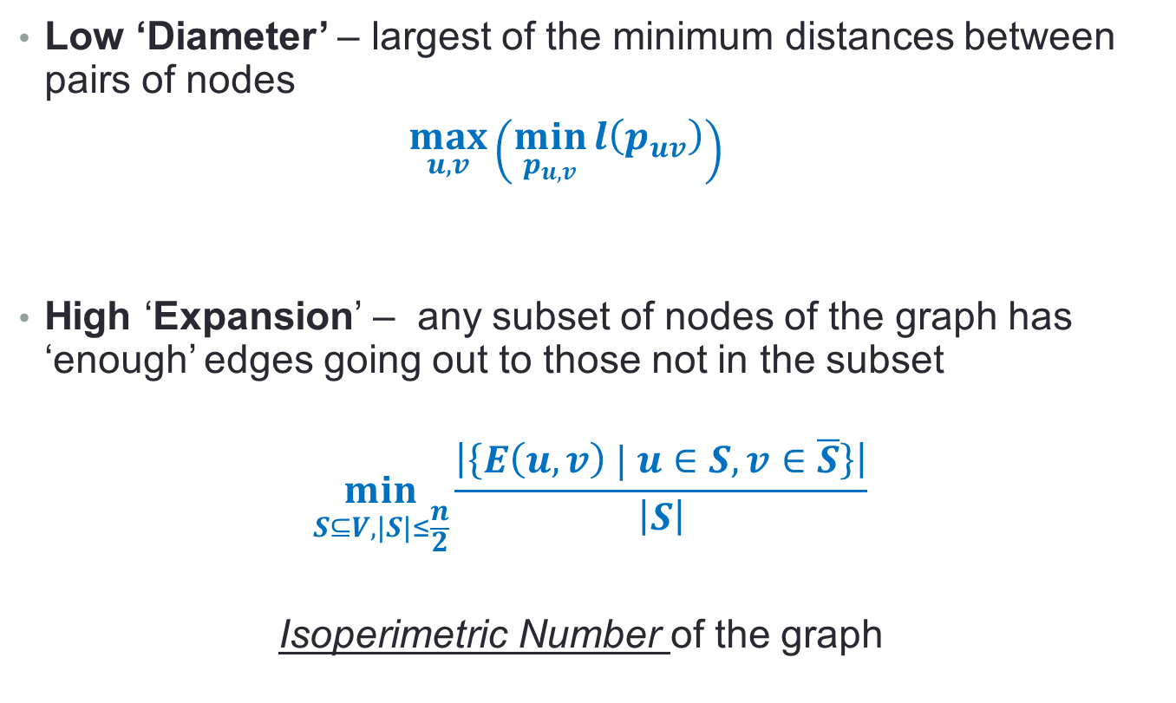
What is ‘Connectedness’?
Low ‘Diameter’ – largest of the minimum distances between pairs of nodes
$\max_{u,v}\left(\min_{p_{u,v}}{l\left(p_{uv}\right)}\right)$
High ‘Expansion’ – any subset of nodes of the graph has ‘enough’ edges going out to those not in the subset
$$\min_{S⊆V, |S|≤\frac{n}{2}}{\frac{\left|\left\{E\left(u,v\right) | u∈S, v∈\overline{S}\right\}\right|}{\left|S\right|}}$$
Isoperimetric Number of the graph

Slide 5
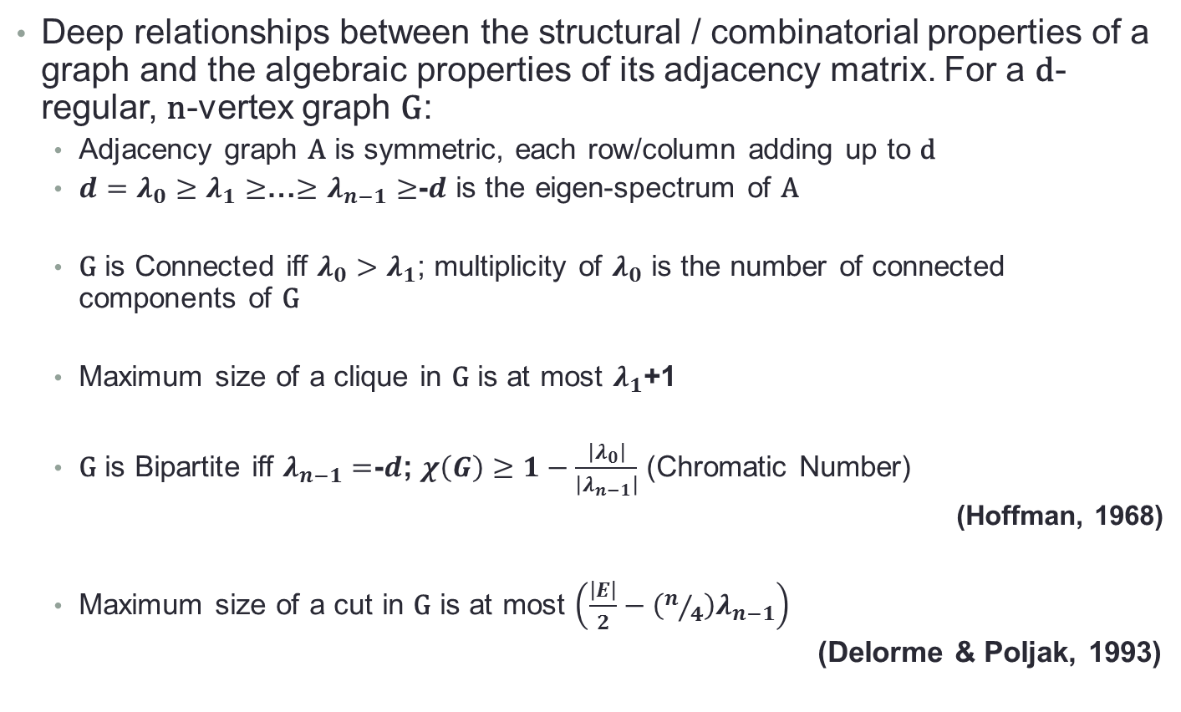
Spectral Graph Theory – Unifying Theme
Deep relationships between the structural / combinatorial properties of a graph and the algebraic properties of its adjacency matrix. For a d-regular, n-vertex graph G:
Adjacency graph A is symmetric, each row/column adding up to d
$d=λ_{0}≥$ $λ_{1}≥$…$≥$ $λ_{n−1}≥$-$d$ is the eigen-spectrum of A
G is Connected iff $λ_{0}>$ $λ_{1}$; multiplicity of $λ_{0}$ is the number of connected components of G
Maximum size of a clique in G is at most $λ_{1}$+1
G is Bipartite iff $λ_{n−1}=$-$d$; $χ\left(G\right)≥1−\frac{\left|λ_{0}\right|}{\left|λ_{n−1}\right|}$ (Chromatic Number)
(Hoffman, 1968)
Maximum size of a cut in G is at most $\left(\frac{\left|E\right|}{2}−\left(n/4\right)λ_{n−1}\right)$
(Delorme & Poljak, 1993)

Slide 6
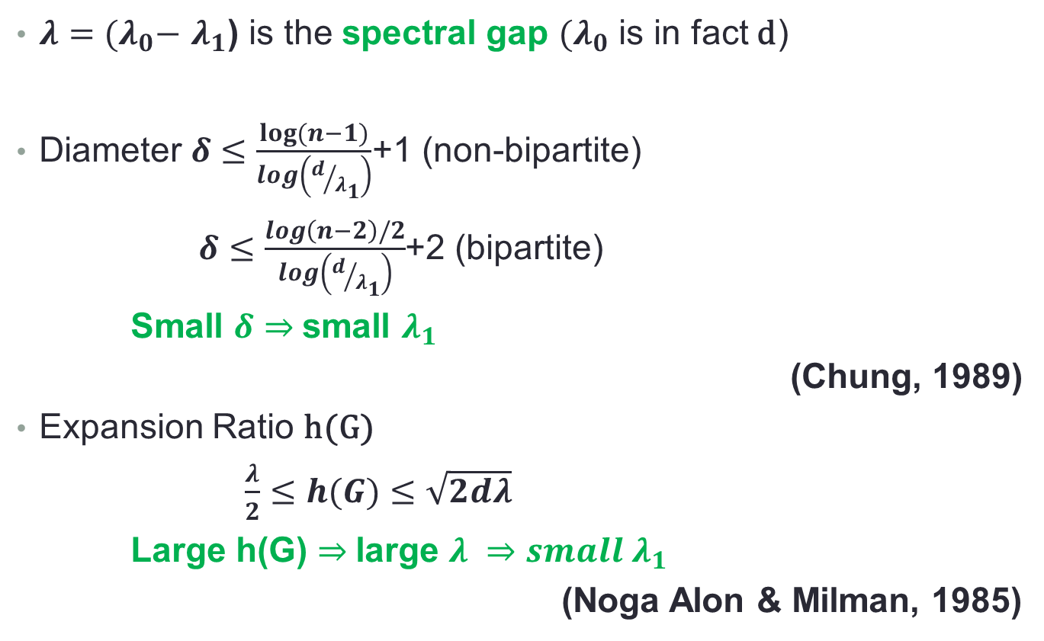
Spectral Gap and Connectivity
$λ={(λ}_{0}−$ $λ_{1}$) is the spectral gap ${(λ}_{0}$ is in fact d)
Diameter $δ≤\frac{log⁡(n−1)}{log\left(d/{λ_{1}}\right)}$+1 (non-bipartite)
$δ≤\frac{\log\left(n−2\right)/2}{log\left(d/{λ_{1}}\right)}$+2 (bipartite)
Small $δ$ $⇒$small $λ_{1}$
(Chung, 1989)
Expansion Ratio h(G)
$\frac{λ}{2}≤h(G)≤\sqrt{2dλ}$
Large h(G) $⇒$large $λ ⇒small λ_{1}$
(Noga Alon & Milman, 1985)

Slide 7
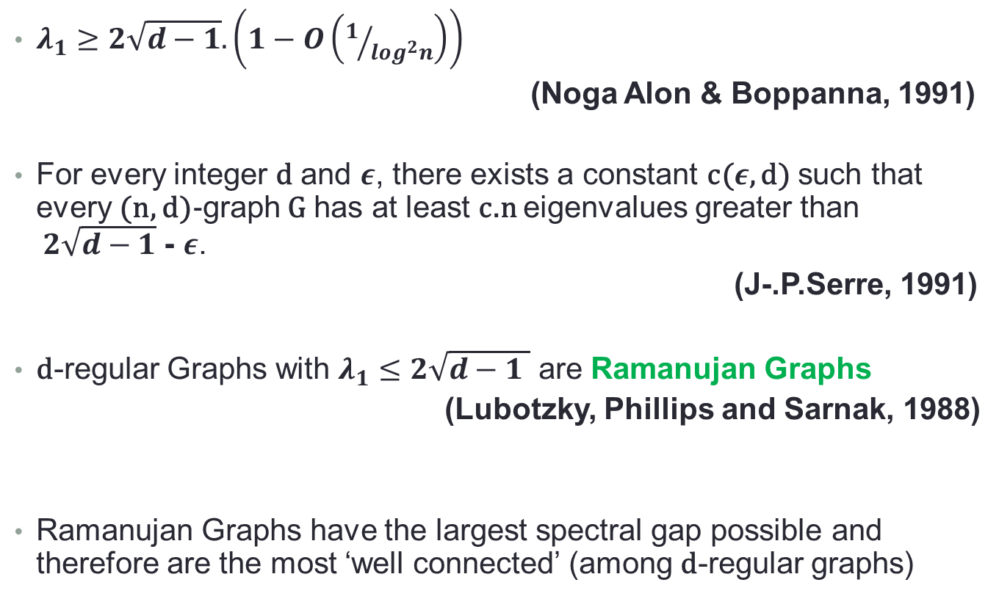
Ramanujan Graphs
$λ_{1}≥2\sqrt{d−1}. \left(1−O\left(1/{\log^{2}n}\right)\right)$
(Noga Alon & Boppanna, 1991)
For every integer d and $ε$, there exists a constant c($ε$, d) such that every (n, d)-graph G has at least c.n eigenvalues greater than $2\sqrt{d−1}$ - $ε$.
(J-.P.Serre, 1991)
d-regular Graphs with $λ_{1}≤2\sqrt{d−1 }$ are Ramanujan Graphs
(Lubotzky, Phillips and Sarnak, 1988)
Ramanujan Graphs have the largest spectral gap possible and therefore are the most ‘well connected’ (among d-regular graphs)

Slide 8
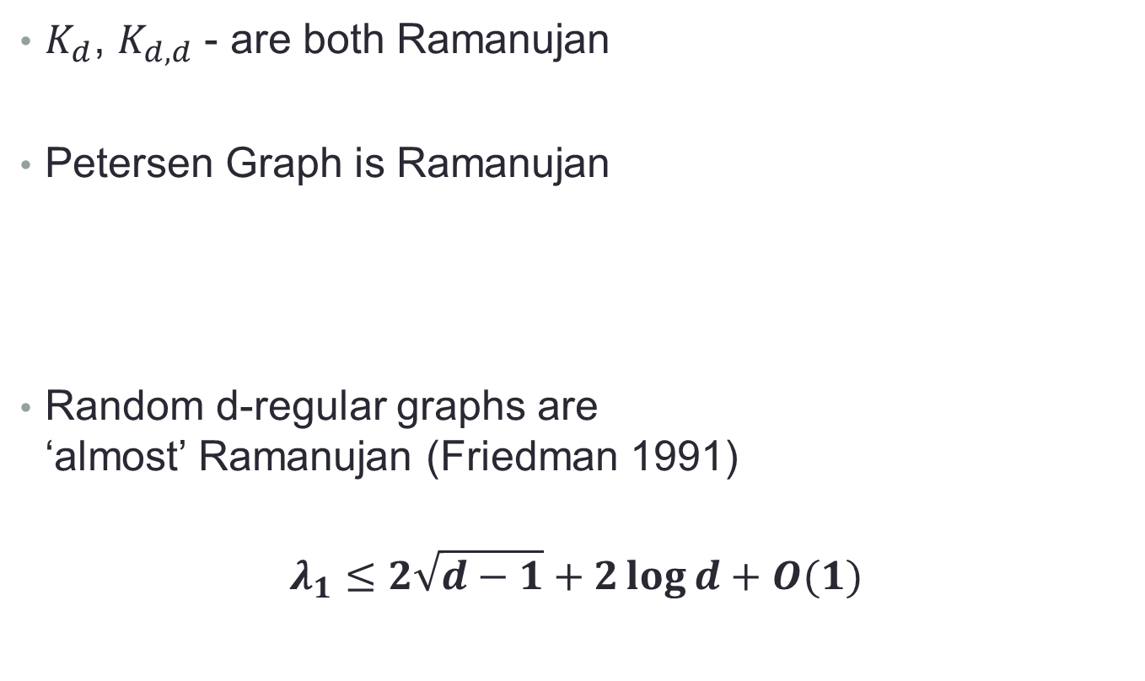
Examples of Ramanujan Graphs
$K_{d}$, $K_{d,d}$ - are both Ramanujan
Petersen Graph is Ramanujan
Random d-regular graphs are ‘almost’ Ramanujan (Friedman 1991)
$$λ_{1}≤2\sqrt{d−1}+2\log{d+O(1)}$$

Slide 9
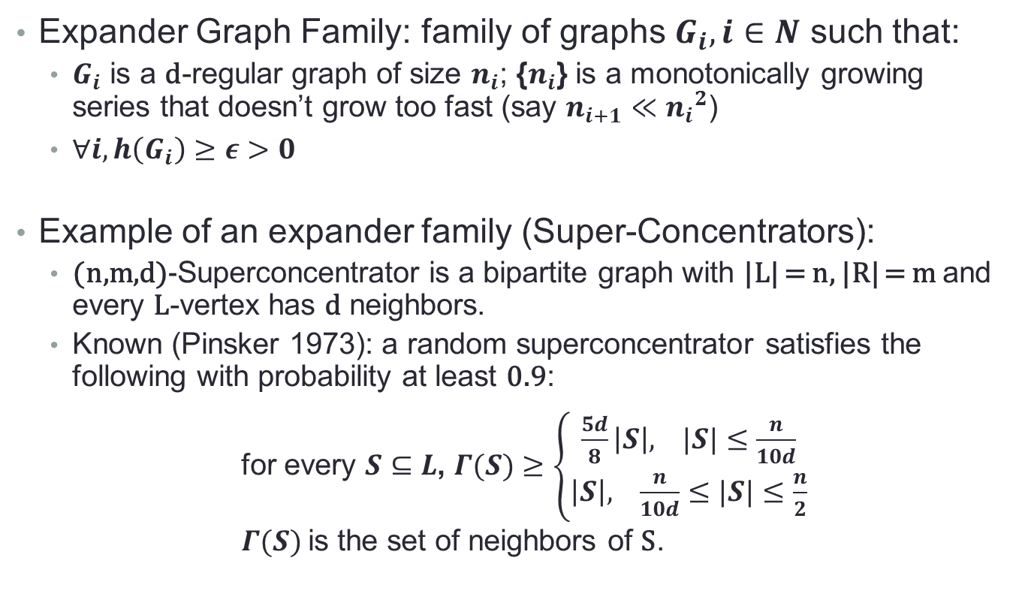
Expander Graphs
Expander Graph Family: family of graphs $G_{i}, i∈N$ such that:
$G_{i}$ is a d-regular graph of size $n_{i}$; {$n_{i}$} is a monotonically growing series that doesn’t grow too fast (say $n_{i+1}≪{n_{i}}^{2}$)
$∀i, h\left(G_{i}\right)≥ε>0$
Example of an expander family (Super-Concentrators):
(n,m,d)-Superconcentrator is a bipartite graph with |L| = n, |R| = m and every L-vertex has d neighbors.
Known (Pinsker 1973): a random superconcentrator satisfies the following with probability at least 0.9:
for every $S⊆L$, $Γ(S)≥\left\{\begin{matrix}\frac{5d}{8}\left|S\right|, |S|≤\frac{n}{10d} \\ \left|S\right|, \frac{n}{10d}≤|S|≤\frac{n}{2}\end{matrix}\right.$
$Γ(S)$ is the set of neighbors of S.

Slide 10
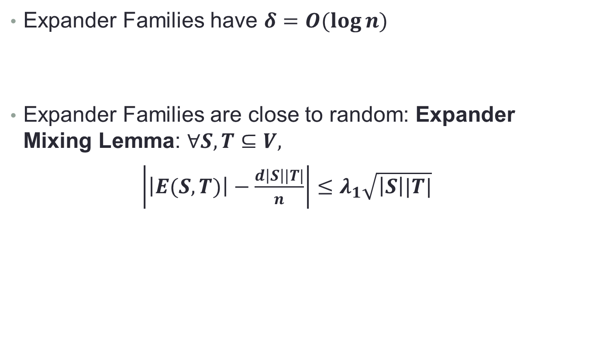
Properties of Expander Graphs
Expander Families have $δ=O(\log{n)}$
Expander Families are close to random: Expander Mixing Lemma: $∀S,T⊆V,$
$\left|\left|E(S,T)\right|−\frac{d\left|S\right||T|}{n}\right|≤λ_{1}\sqrt{\left|S\right||T|}$

Slide 11

Margulis Construction (1973)
$G\left(Z_{m} X Z_{m}\right)=\left(x,y\right)→\left\{\begin{aligned}\begin{matrix}\left(x±y, y\right) \\ \left(x±\left(y+1\right), y\right) \\ \left(x, y±x\right)\end{matrix} \\ \left(x,y±\left(x+1\right)\right)\end{aligned}\right\}$, mod m
Graphs with $m^{2}$ vertices and $λ_{1}≤8$

Slide 12
Expander Families that are Ramanujan
What we really need are families of expander graphs that are Ramanujan (Ramanujan Families)
Constructions exist now – but are highly non-trivial. Proofs of ‘Ramanujan-ness’ have used a wide range of deep mathematics – Representation Theory of Lie Groups, Number Theory, Algebraic Geometry, …

Slide 13
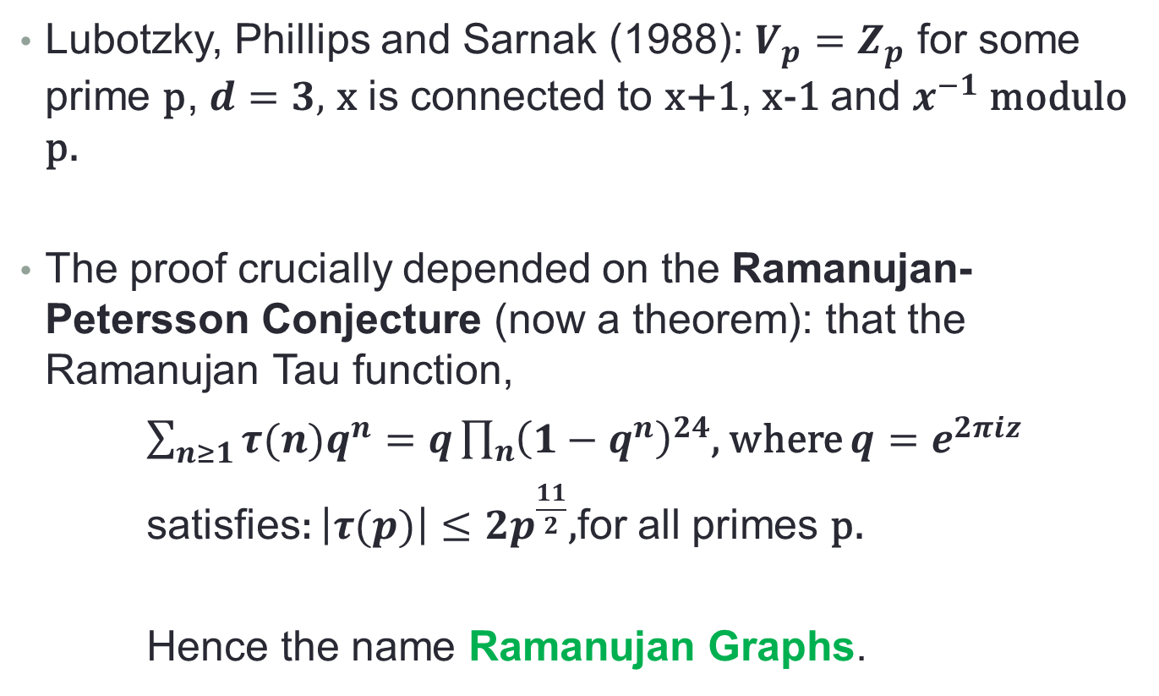
Examples of Ramanujan Families
Lubotzky, Phillips and Sarnak (1988): $V_{p}=Z_{p}$ for some prime p, $d=3,$ x is connected to x+1, x-1 and $x^{−1}$ modulo p.
The proof crucially depended on the Ramanujan-Petersson Conjecture (now a theorem): that the Ramanujan Tau function,
$\sum_{n≥1}{{τ(n)q}^{n}}=q\prod_{n}{{\left(1−q^{n}\right)}^{24}}$, where $q=e^{2πiz}$
satisfies: $\left|τ(p)\right|≤2p^{\frac{11}{2}}$,for all primes p.
Hence the name Ramanujan Graphs.

Slide 14
Ramanujan Families of Arbitrary size?
Construction of Ramanujan families for any n other than primes and prime powers remains an important open problem.

Slide 15
References
Sanjeev Arora, and Boaz Barak. Computational Complexity – A Modern Approach. Cambridge University Press. 2009.
S. Hoory, N. Linial, and A. Wigderson. Expander Graphs and their Applications. Bull. AMS, Vol. 43 (4), (2006).
Lazlo Lovasz. Eigenvalues of Graphs. Unpublished Manuscript. 2007.
M. Ram Murty. Ramanujan Graphs. J. Ramanujan Math. Soc. 18 (2003)

Slide 16
Thank You
G.Srinivasaraghavan, IIIT-B

